Slide 1
أُنْس

Slide 2
Ons Application
An Application to show the zikr periodically
It is rule : To make the user remember the zikr
It is advantages : show zikr , add zikr and display zikr

Slide 3
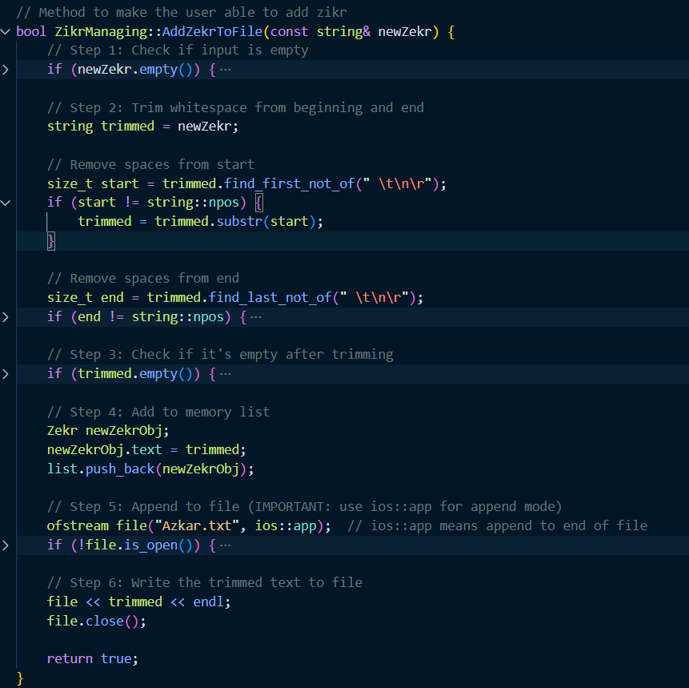
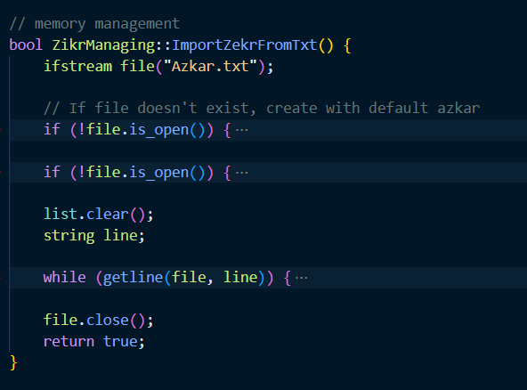
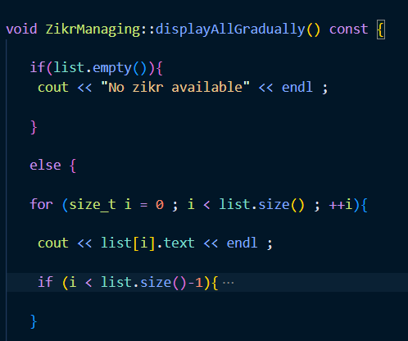
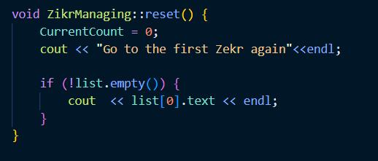
Programming Code
Third Method
First Method
Second Method
Forth Method

Slide 4
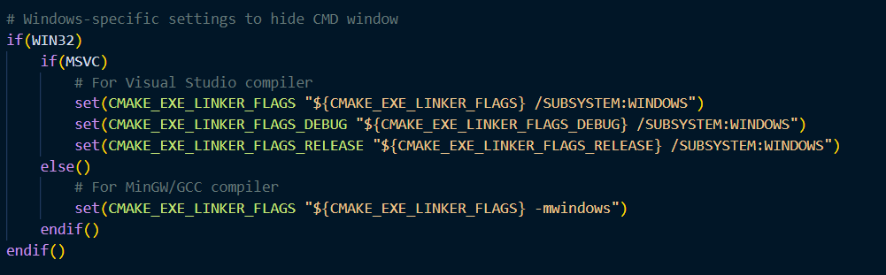
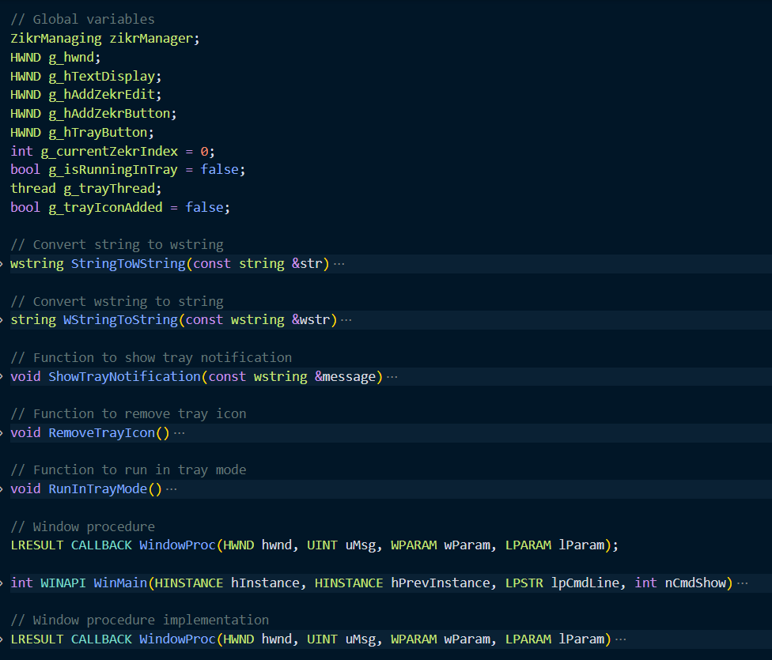

Challenges and Solutions
Learning to use Windows GUI and Windows API So Study the official Windows API documentation and try practical GUI examples
1.Appearance of CMD window when running the application So I modify CMakeLists.txt to use /SUBSYSTEM:WINDOWS
2.Opening the audio file interface So I replace ShellExecuteA with the PlaySoundA function.

Slide 5
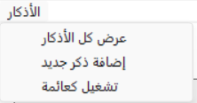
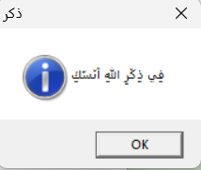
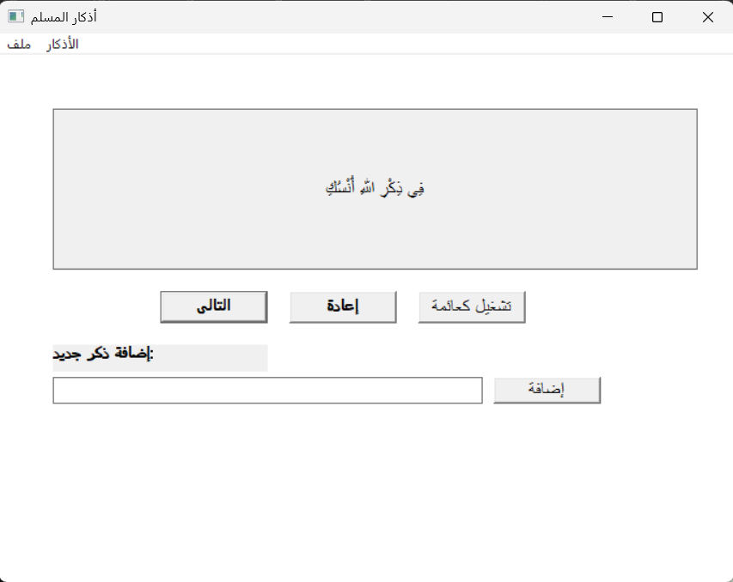
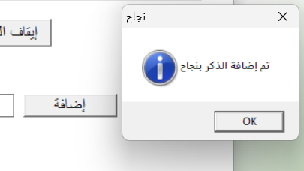
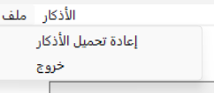
Results
Floating window
Azkar button
Application interface window
Adding new zikr
Files button

Slide 6
Any Questions??!

